Slide 1
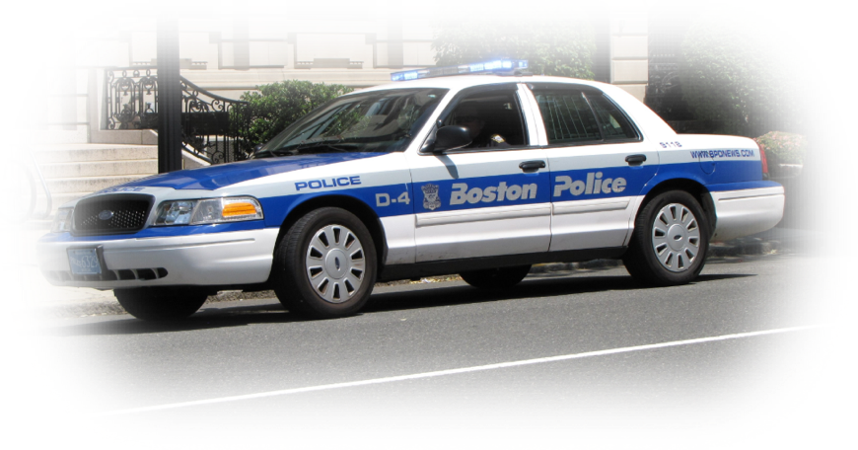


Boston crimes
ALY6040 90650 - Data Mining Applications
Professor: Amin Karimpour
Date: 08/14/2019
Northeastern University
Group Alpha:
Thi Thai Ngan Le
Maryam Heidari
Findlee Odili-Obi

Slide 2
Outline
Background
Introduction
Dataset Information
Methods Used
Analysis Questions
Data Analysis
EDA
Clustering
Time Series
Conclusion & Summary
References

Slide 3
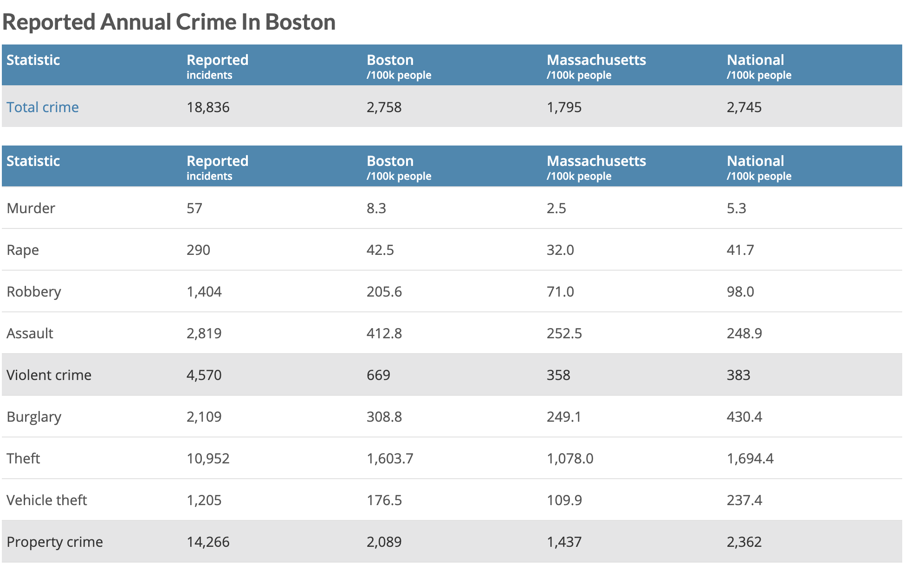
Background
Crime rates in Boston spikes every hour.
Multiple crimes in multiple locations
Crimes range from man slaughter, to auto theft, to burglary etc.
Many residents tend to move to other cities or states.

Slide 4

introduction
Dataset Information
Analysis Question:
What locations are prone to more crimes?
What are the level of crimes?
Does the frequency change over time?
What is the trend for the next coming years?
How can the results be applied?
319,073 obs, 17 variables
We subset dataset to select important variables
No missing data
Methods Used
EDA using R-Shining analysis tool
Clustering
Time series

Slide 5
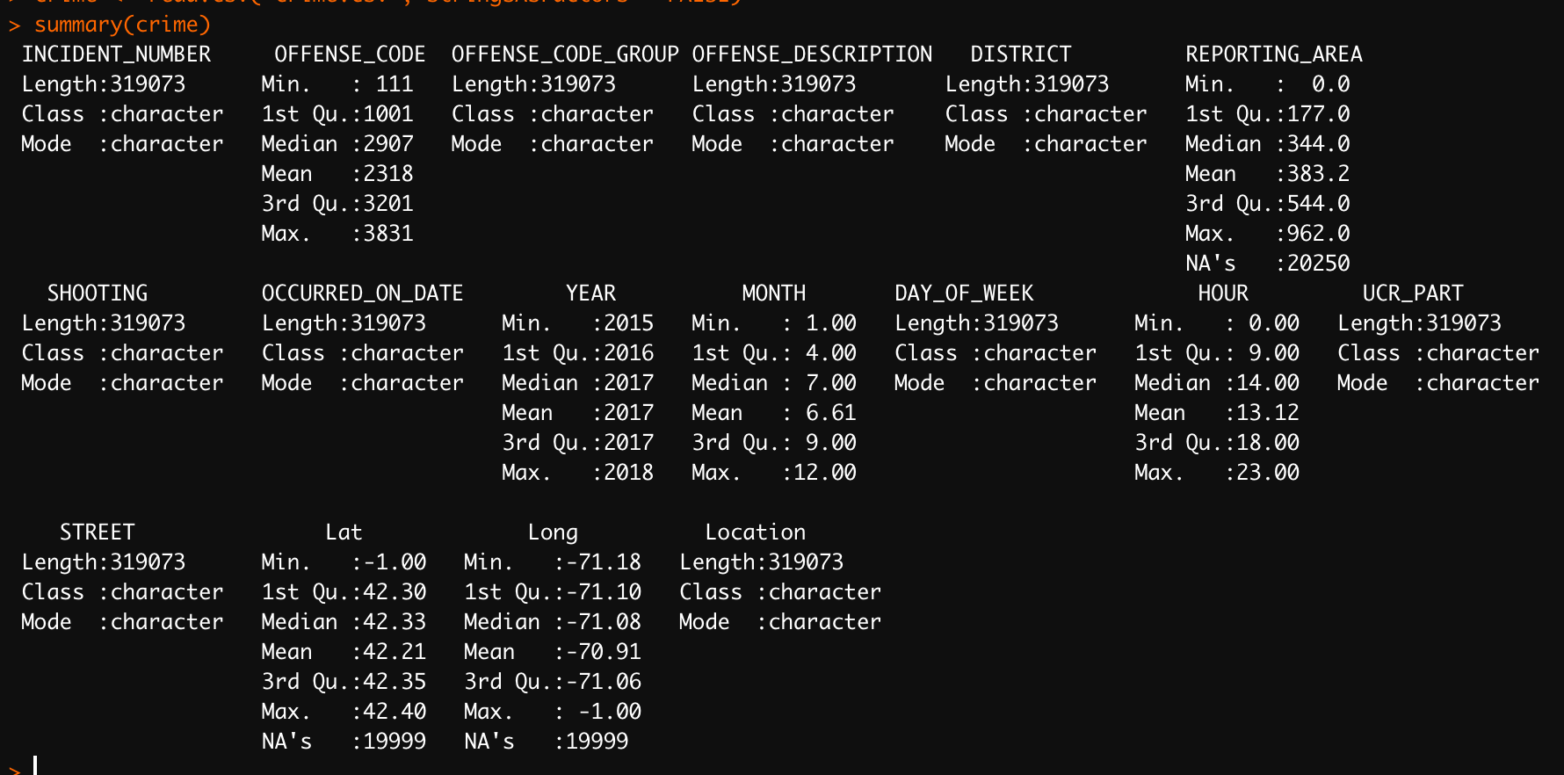
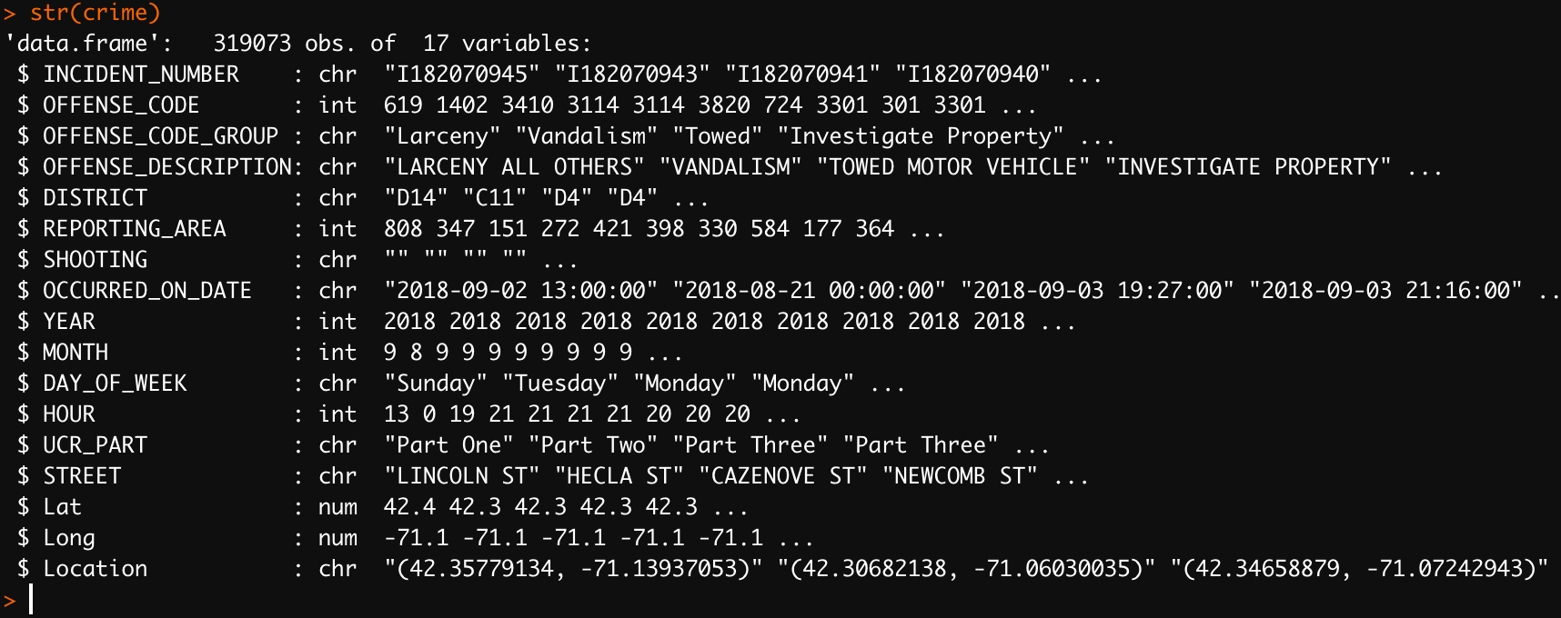
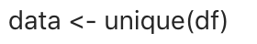
Data analysis
Data Cleaning - EDA
7 Variables out of 17: OFFENSE_CODE_GROUP, DISTRICT, YEAR, MONTH, DAY_OF WEEK, HOUR, UCR_PART
Missing Values
Duplicate Values

Slide 6
EDA
Exploratory Data Analysis – UCR_PARTs
UCR_PART was Separated in 4 parts
Part 1 – Highly Serious Crimes
Part 2 – Serious Crimes
Part 3 – Less Serious Crimes
Part 4 – Other

Slide 7
EDA (CONT’D)
Exploratory Data Analysis – UCR_PARTs

Slide 8
eda CONT’D
By Hours
By Months
By Days of Week
By Years

Slide 9
eda CONT’D
Crimes By Districts
A-1 & A-15 Downtown & Charlestown
A-7 East Boston
B-2 Roxbury
B-3 Mattapan
C11- Dorchester
C-6 South Boston
D-14 Brighton
D-4 South End
E-13 Jamaica Plain
E-18Hyde Park
E-5 West Roxbury

Slide 10
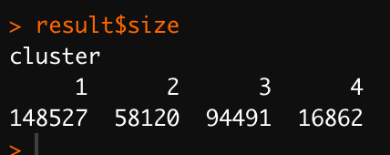
CLUSTERING
CLUSTERING – using klaR package
Time of crime: HOURS, DAYS OF WEEK, MONTHS, YEARS
Type Of Crime: OFFENSE_CODE_GROUP
Location: DISTRICT OF CRIME

Slide 11
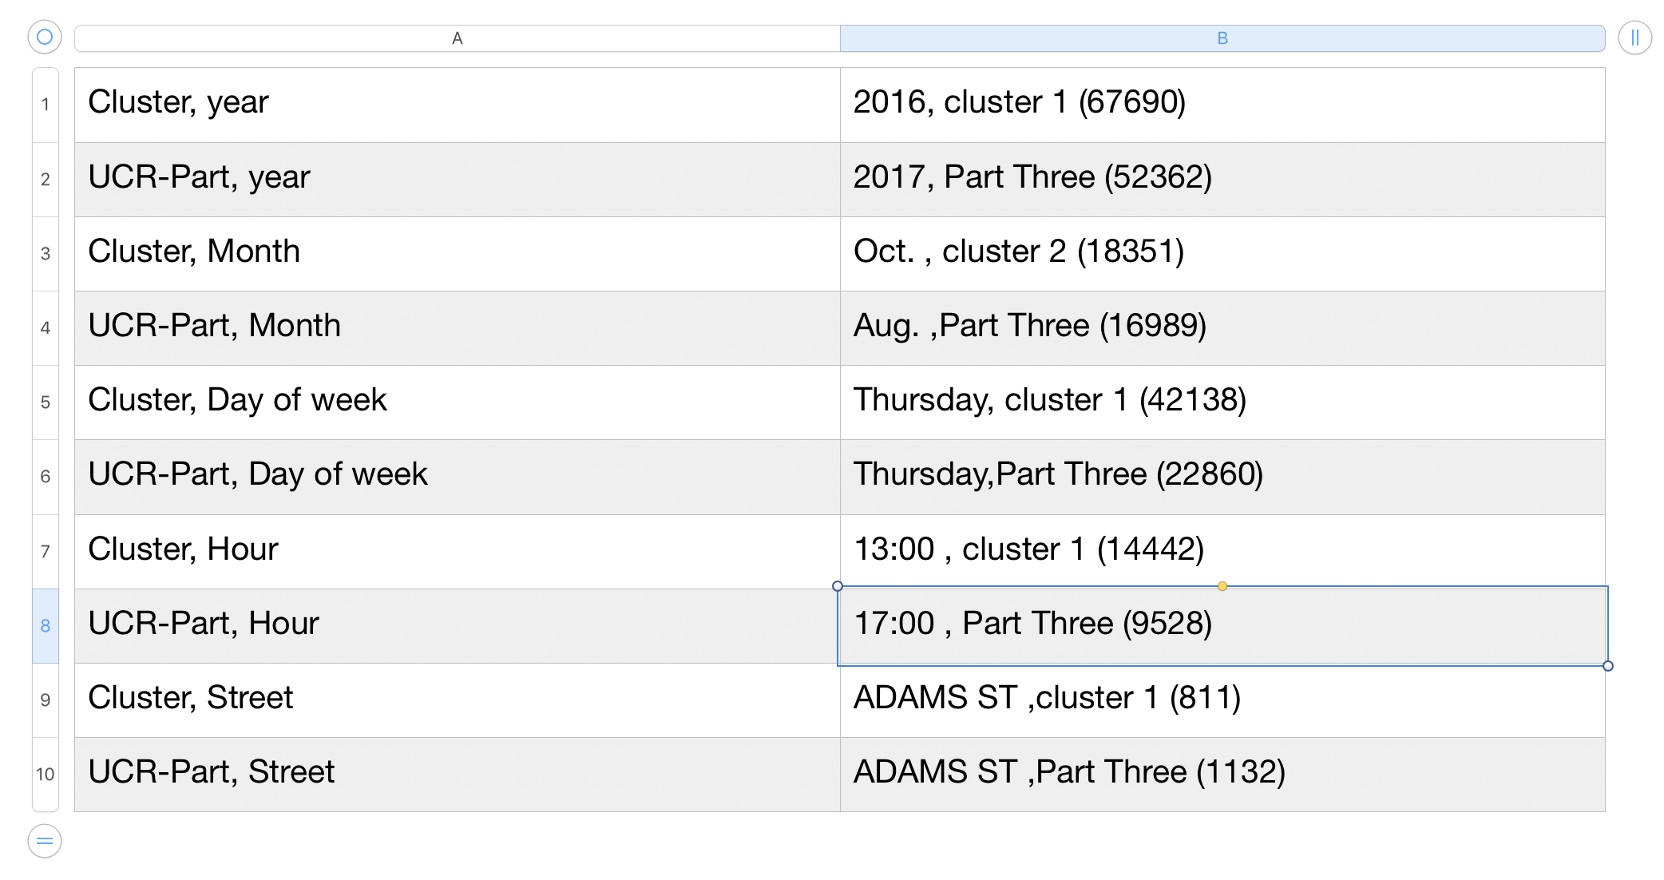
Methods comparison

Slide 12
Time series
Time Series for Crime based on year
Every year has a seasonal effect at the end.

Slide 13
Time series (CONt’d)
We deleted the seasonal effect to have a Deseasonal time series;

Slide 14
Time series (CONt’d)
Using the ARIMA function, we found parameters for forecasting crime trend in the future

Slide 15
Conclusion & summary
Based on our analysis;
Locations or districts prone to more crimes
Levels of crimes based on the offense_codes
Number of crimes increase by time – 2020 to 2022
Can be useful to both civilians and the police.
Thanks!!!
Q&A?

Slide 16
References
City Comparison Results. (2019). Retrieved 13 August 2019, from https://www.areavibes.com/compare-results/?place1=Quincy%2C%20MA&place2=Boston%2C%20MA#cri
Crimes in Boston. (2019). Retrieved 10 August 2019, from https://www.kaggle.com/AnalyzeBoston/crimes-in-boston/

